Slide 1
Ruthwik Shanmukh Ganesh DIYAA
Team

Slide 2
Website
https://www.mixo.io/site/pawpal-ie0u5

Slide 3
Explainer video
https://youtu.be/VySNcdtmcUU

Slide 4
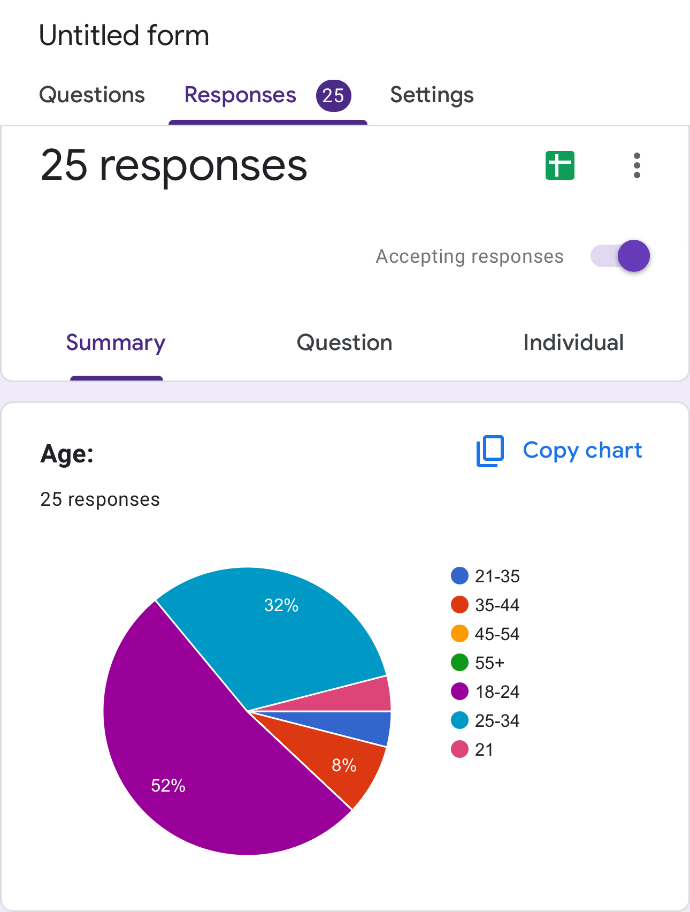
Results
Target metric:
Alignment with Smart Collar Goals
Usability:
Respondents emphasized the importance of intuitive notifications and features like health and emotional monitoring, which align with your goals.
Core Features:
GPS tracking, health updates, and safety checks are valued, indicating a strong fit with your target feature set.
Durability and Pet-Friendliness:
While respondents did not directly comment on durability, the emphasis on comfort and usability implies this as a baseline expectation.
Identified Gaps:
Enhanced Features: Suggestions like customizable diets, socialization insights, and pet-sitter collaboration tools highlight areas for growth.
Cost Sensitivity:
Most respondents preferred a subscription cost in the $5-$15 range, indicating sensitivity to higher price points.

Slide 5
MVP of Solution
Target Metric and Result
We Shared our form to 153 people and we got response of 25(12.5) which is much lesser excepted response
We expected around 70 of response which is 50%
Based on key Options 5,6,7,8,10, the interested people to choose the product is 7 people out of 25.

Slide 6
User Narrative
Negatives
Feature Gaps: Missing diet customization and deeper emotional monitoring.
Onboarding Issues: Setup was not intuitive for some users.
Cost Sensitivity: Resistance to pricing above $15/month.
Overlooked Personas: Limited focus on pet sitters and caregivers.
Positives
Core Features Validated: GPS tracking and health monitoring were highly appreciated.
User Engagement: Pet-sitter tools and visual reports boosted satisfaction.
Affordable Pricing: $5-$15/month resonated well with users.
Ease of Use: The app's simplicity was praised.
Developed MVP
Feedback Received
Analyzed feedback
Only 7 respondents showed intent to buy. Highlights possible gaps in perceived value, pricing, or product-market fit.
Based Customer visits and responses
25 out of 153
Evaluated MVP
Out of 25 people, 12 are willing to keep their dog in a pet care center rather than buy devices, 5 do not travel frequently enough to require a device, and 7 are interested.
Pivot
Product reaching people requirement but the percentage of people who are interested are very less then expected which makes the product fail

Slide 7
Persevere, Iterate or Pivot
Pivot Low Market Relevance: Only 3.5% (7 buyers) of the total target audience expressed interest, indicating limited appeal to the broader market.
Niche Demand: Emotional wellness and behavioral training resonate strongly with a specific subset of users (owners of anxiety-prone or behaviorally challenged pets).
Pricing Concerns: Sensitivity to subscription costs ($5–$15/month) limited wider adoption.

Slide 8
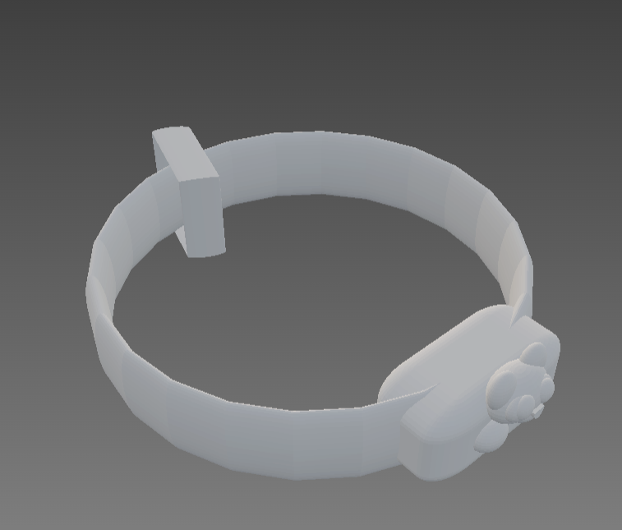
Smart collar

